Slide 1
Chapter 2 (Continued)
Chapter2_3.ppt
Dr. Ning Chen

Slide 2
Translating a MIPS Assembly Instruction into a Machine Instruction
Task: Given a MIPS instruction, translate it to a machine instruction
Add $t0, $s1, $s2
Ans:
Before we try, let’s answer some interesting questions:
How many bit(s) do we need to represent one object out of two objects?
How many bits do we need to represent one object out of four objects?
How many bits do we need to represent one MIPS register?
Ans: 5 bits (since we have 32 registers).

Slide 3
MIPS field (R-type)
op | rs | rt | rd | shamt | funct
6 bits | 5 bits | 5 bits | 5 bits | 5 bits | 6 bits

Slide 4
op: Opcode
rs: Register source
rt: Register source
rd: Register destination
shamt: shift amount
funct: Function

Slide 5
MIPS Instruction
Add $t0, $s1,$s2
Machine code in binary
000000 10001 10010 01000 00000 100000
Machine code in Decimal
0 17 18 8 0 32

Slide 6
What about lw $t0, 32($S3)?
Q. Can R-type MIPS field work for the lw instruction?
A. No.
Q. What should be the field format for lw?
A.
op | rs | rt | constant or address
6 bits | 5 bits | 5 bits | 16 bits

Slide 7
Example:
C code
A[300]=h + A[300];
MIPS assembly code
lw $t0, 1200($t1)
add $t0,$s2,$t0
sw $t0, 1200($t1)
Machine code in decimal
op | rs | rt | rd | Address /shamt | function
35 | 9 | 8 | 1200
0 | 18 | 8 | 8 | 0 | 32
43 | 9 | 8 | 1200

Slide 8
I-Format (Immediate)
Addi $s3,$s3,4 #$s3=$s3+4
I-Format
Opcode | rs | rt | Immediate (16 bits)

Slide 9
Logical Operations
Sll $t2,$s0,4 #reg $t2=reg$s0 << 4 bits
op | rs | rt | rd | shamt (5 bits) | funct
0 | 0 | 16 | 10 | 4 | 0

Slide 10
Instructions for making decisions
C code: if –then-else
if (j==j) f=g+h;
else
f=g-h;
Assembly code
bne $s3,$s4, Else #go to Else if i≠ j
add $s0,$s1,$s2 #f=g+h
J Exit #go to Exit
Else: sub $s0,$s1,$s2
Exit:

Slide 11
J-format
j Exit
opcode | Address (26 bits)

Slide 12
Branch instruction
Bne $s3, $s4, Else
Machine code format:
opcode | rs | rt | address (16 bits)

Slide 13
Any observations?
Branch instructions actually use I-format. Nevertheless, the least significant 16 bits (lower 16 bits) have different meaning.

Slide 14
Five MIPS addressing modes
Immediate addressing
Register addressing
Base addressing
PC-relative addressing
Pseudodirect addressing

Slide 15
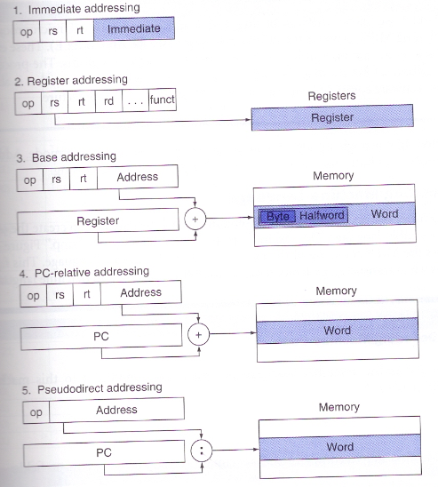
Five MIPS addressing modes

Slide 16
Architecture design decisions made so far
32 registers with 32-bit width
Byte memory arrangement
2³² bytes memory space
5 addressing modes
3 basic instruction formats (R, I and J)

Slide 17
Some architecture design decisions need more careful considerations (will explore those in Chapter 4)
A branch instruction uses only 16 bits as address. (It does not take you to anywhere in the memory you want to go. Is this a problem?)
A jump label (e.g., j Exit) instruction uses only 26 bits as address. (It does not take you to anywhere in the memory you want to go. Is this a problem?)

Slide 18
Concluding remarks: Less is more.
Simplicity favors regularity
Smaller is faster
Make the common case fast
Good design demands good compromise

